Slide 1







MySQL
BLINKIT SALES DATA ANALYSIS
Shubham Kumar
Role: Data Analyst

Slide 2







Objective
To analyze sales performance, customer ratings, and product distribution within Blinkit’s dataset, uncovering key patterns and improvement areas using SQL-based KPIs and provide oppertunities for Power BI visualizations.

Slide 3

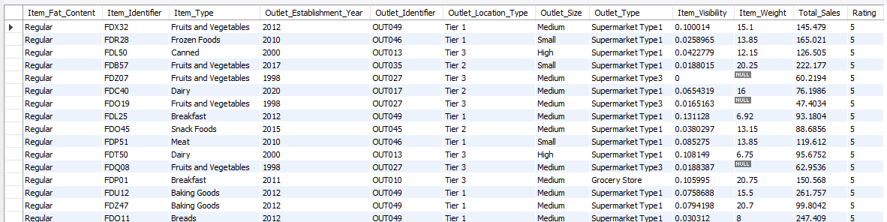


DATASET OVERVIEW
Number of Records: 8523

Slide 4







Data Cleaning Summary
Removed NULLs in Item_Weight
Converted Item_Visibility & Total_Sales to float
Ensured correct data types (e.g., INT, VARCHAR, DECIMAL)

Slide 5
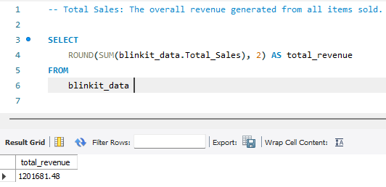

Total Revenue
Business Value: Measures customer engagement.

Slide 6
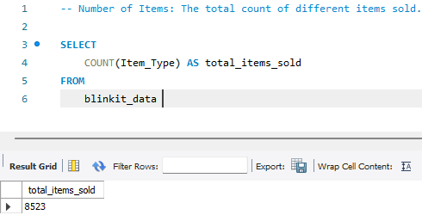
Total Items Sold

Slide 7
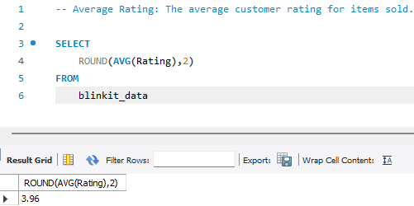
Average Rating

Slide 8
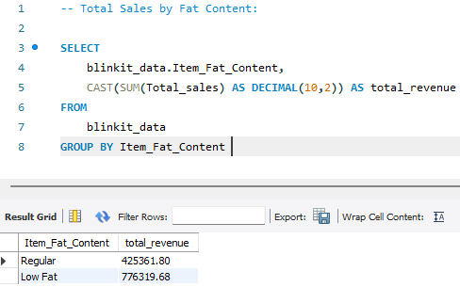
Total Sales by Fat_Content

Slide 9
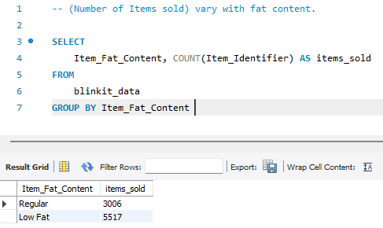
Items Sold vary with Fat_Content

Slide 10
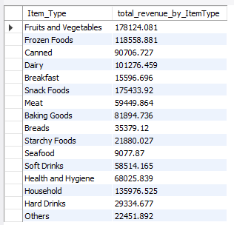
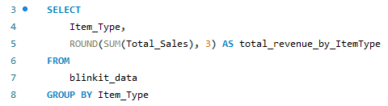
Total Sales by Item Type

Slide 11
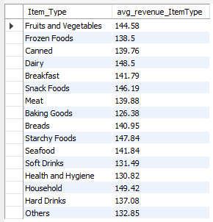
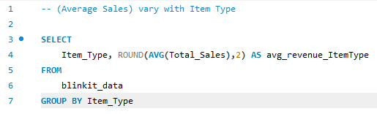
Average Sales vary with Item Type

Slide 12
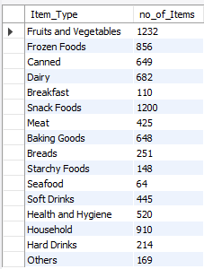
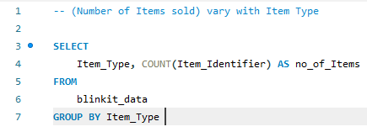
Number of Items sold vary with Item Type

Slide 13
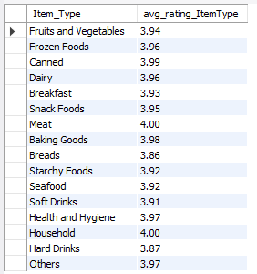
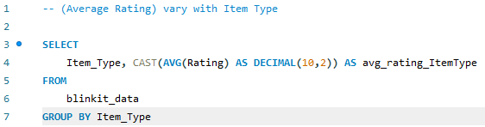
Average Rating vary with Item Type

Slide 14
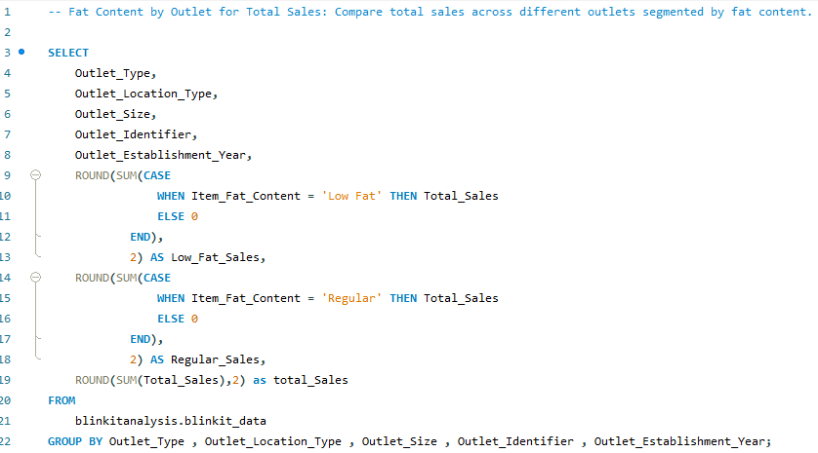
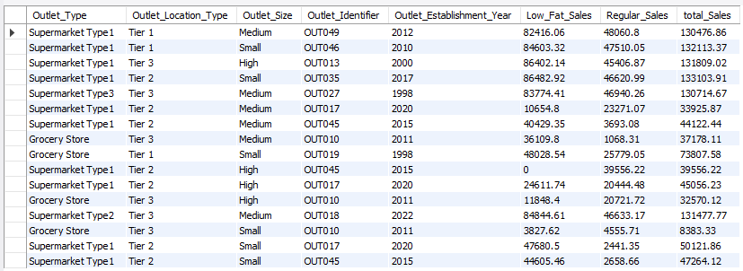
Fact Content by Outlet for Total Sales

Slide 15
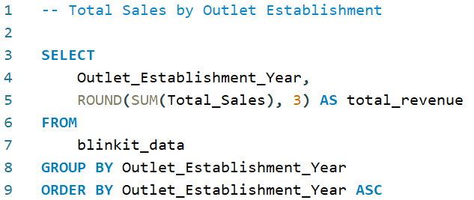
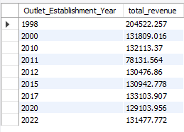
Total Sales by Outlet Establishment Year

Slide 16
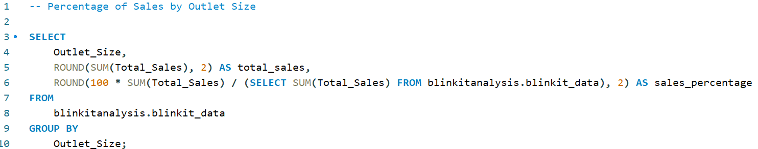
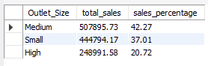
Percentage of Sales by Outlet Size

Slide 17
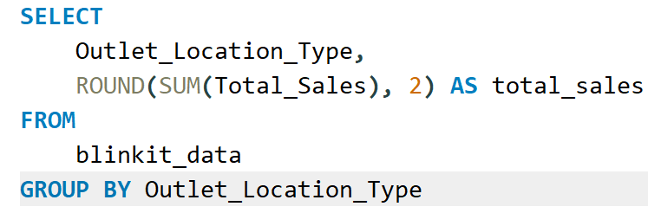
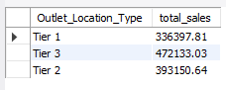
Sales by Outlet Location

Slide 18
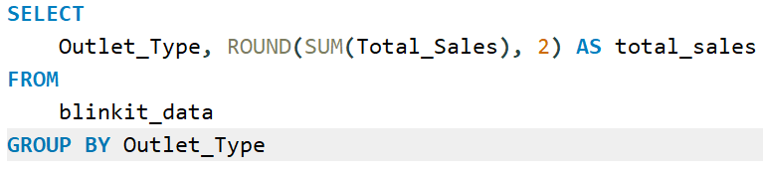
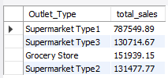
Total Sales broken down by different outlet types

Slide 19
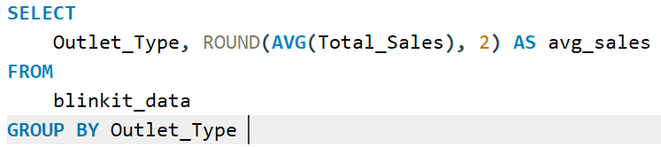
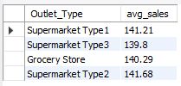
Average Sales broken down by different outlet types

Slide 20
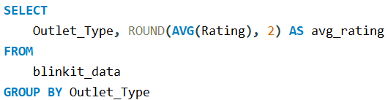
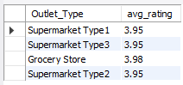
Average Rating broken down by different outlet types

Slide 21
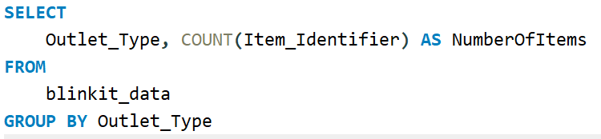
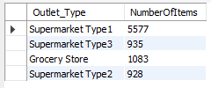
Number of Items broken down by different outlet types

Slide 22





Insights & Observations
Low Fat items generated more total sales than Regular items, indicating a growing preference for healthier products.
Outlets in Tier 1 cities showed significantly higher sales than those in Tier 2 and Tier 3.
Snack Foods and Fruits & Vegetables were among the top-selling item types.
Medium-sized outlets contributed the highest percentage of total sales, followed by large outlets.
Outlets established after 2000 showed steady growth in performance, suggesting newer outlets are performing competitively.
The average rating across all products is around 4.0, reflecting overall customer satisfaction.

Slide 23


Business Recommendations
01
Increase inventory and promotional focus on Low Fat product lines, especially in Tier 1 locations.
02
Expand high-performing item categories like Snack Foods and Fruits & Vegetables in underperforming locations.
03
Invest in medium-sized outlets across emerging cities, as they show better return on sales performance.
04
Improve product visibility and customer engagement in Tier 2 and Tier 3 cities using location-specific campaigns.
05
Conduct further product-level analysis to identify low-rated items that may need quality or packaging improvement.

Slide 24





THANK YOU

